Slide 1
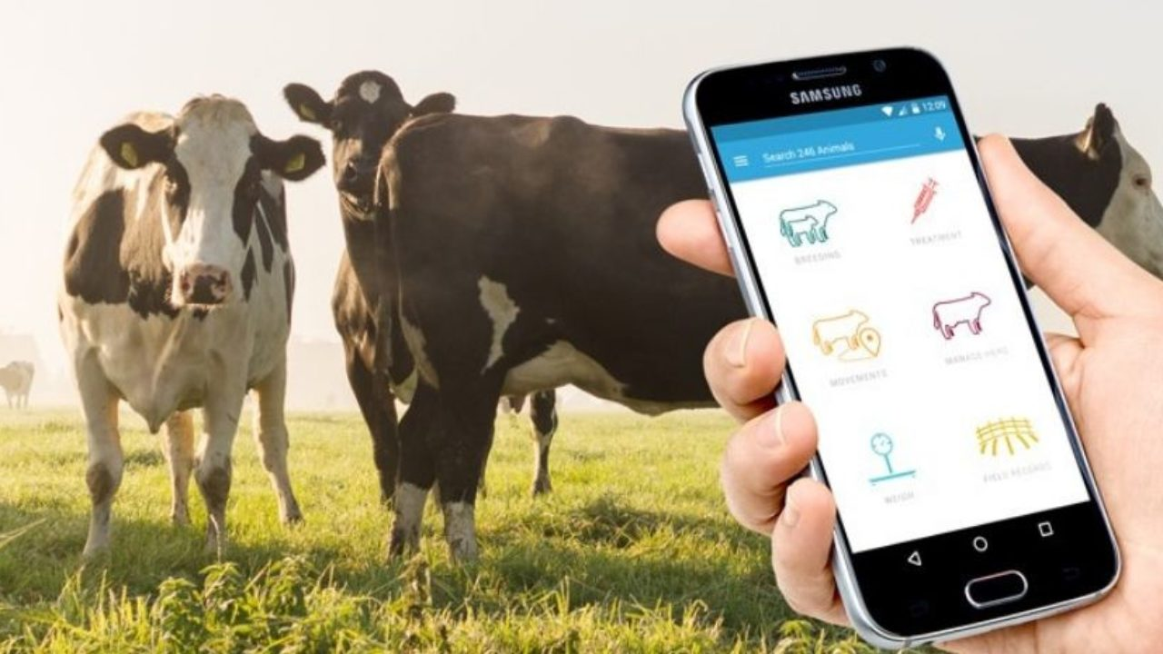




Smart Dairy Digital Transformation
From Traditional Farm to Technology-Enabled Enterprise
A Smart Group Company
Bangladesh
February 2026

Slide 2
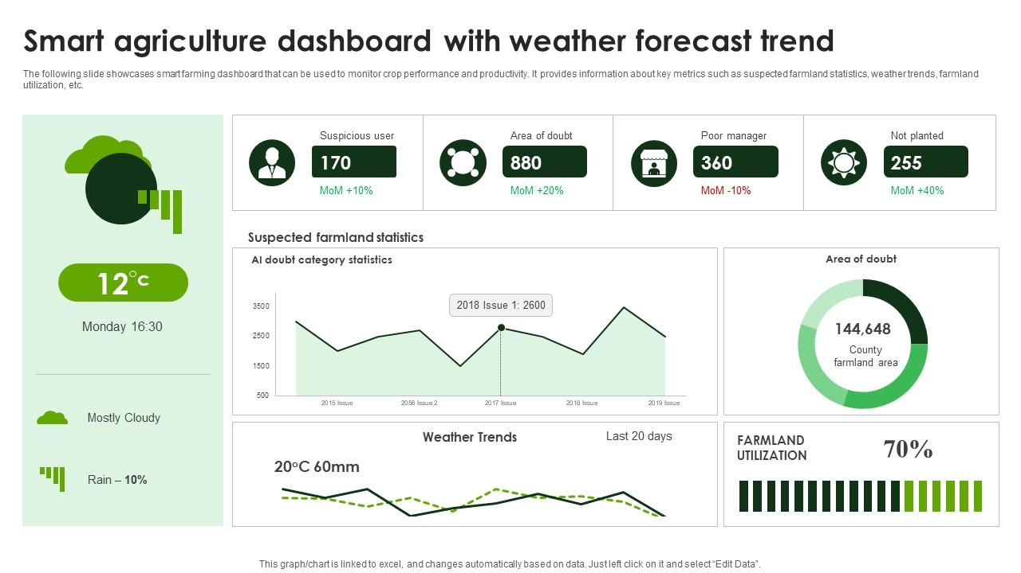







Executive Summary
Project Duration
24-30
Months
Digital Platform
5 Web Portals
•
3 Mobile Apps
•
Odoo ERP
Key Objectives
• 100% Process Digitization
15
150
• 70% Reduction in Manual Data
Implementation Phases
Total Milestones
• Support BDT 100+ Cr Operations
Investment
BDT 7.00 Cr
Total:
3
99.9%
Full-Stack Developers
Target Uptime

Slide 3













Company Background
Smart Dairy Ltd.
A Smart Group Company • Est. 1998
Saffron Brand Products
Cattle
Production
Organic Milk (1L)
Mattha (1L)
255
900
Sweet Yogurt (500g)
Organic Butter
head
L/day
Organic Cheese
Organic Beef (2kg)
Lactating
Products
75
5
cows
types
100% Organic
Antibiotic-Free
Sustainable
Growth Targets (2-Year)
Smart Group Heritage: 20 Sister Concerns • 1,800+ Employees • 2,500+ Clients • International Presence
800
250
3,000
213%
Cattle
Lactating
L/day
Growth

Slide 4
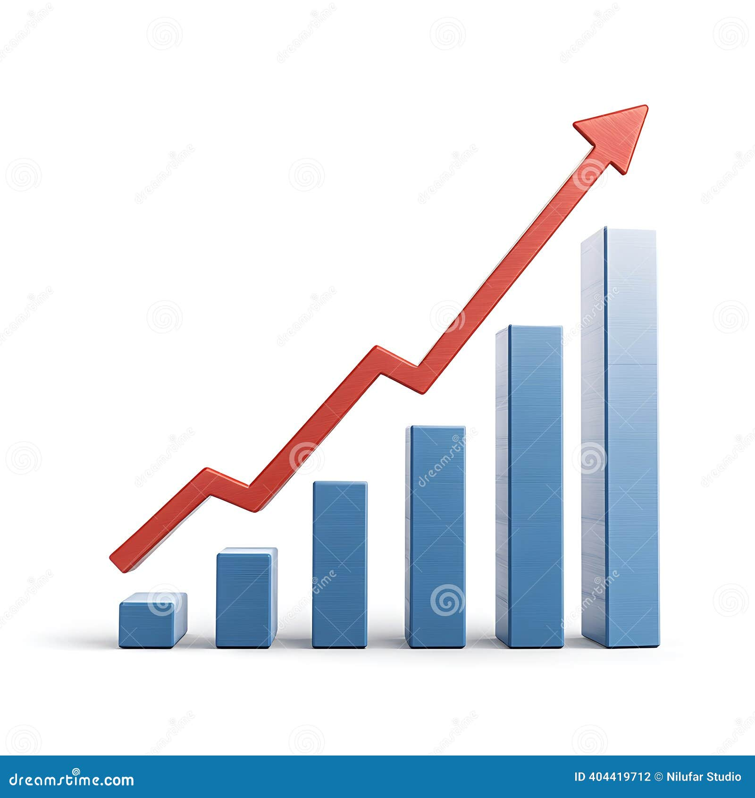










Bangladesh Dairy Market Opportunity
Market Size 2024
Annual Growth
$4.6B
9.04%
Consumer Trends Driving Growth
Projected to $6.5B by 2032
CAGR 2024-2029
Health Consciousness
Rising demand for organic, pure products
Premium Willingness
30-100% premium acceptance for quality
Supply-Demand Gap
Digital Adoption
Demand
Production
75%+ smartphone penetration • E-commerce growth
14.02
56.5%
6.09
Traceability Demand
Million MT/year
Deficit
Million MT/year
Consumers want product origin transparency
Global Ranking
Import Bill
56.5%
$6.5B
170M+
5th in Asia • 19th Worldwide
$
93.4M+
Annually
Supply Gap
2032 Market
Population

Slide 5
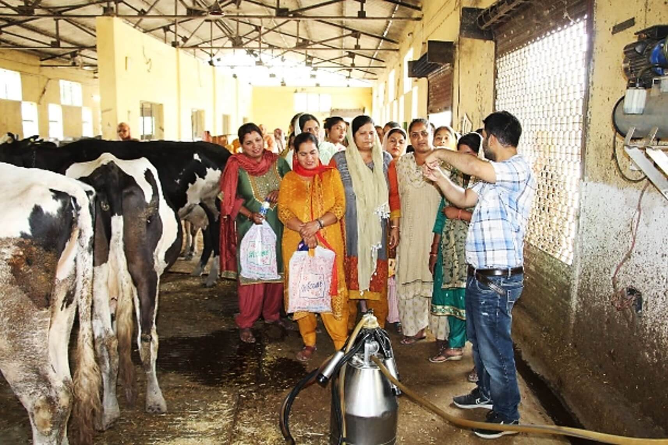













The Challenge
Traditional Farming Limitations
Growth Ambition vs. Operational Reality
Current
Target
Manual Operations
255
800
cattle
213%
cattle
Paper records, spreadsheets, no backup, delayed decisions
No Digital Sales
No e-commerce, no B2B portal, limited market reach
Data Entry
Inventory
100%
~80%
Fragmented Processes
Manual
Accuracy
Separate systems, manual data transfer, delayed reporting
Processing
Quality
4+ hrs
Zero
Traceability Gap
Growth Constraints
Cannot prove quality claims
Manual processes can't scale 213%
Order Time
Tracking
Critical Gap: Manual processes cannot support planned 213% growth while maintaining quality and efficiency

Slide 6
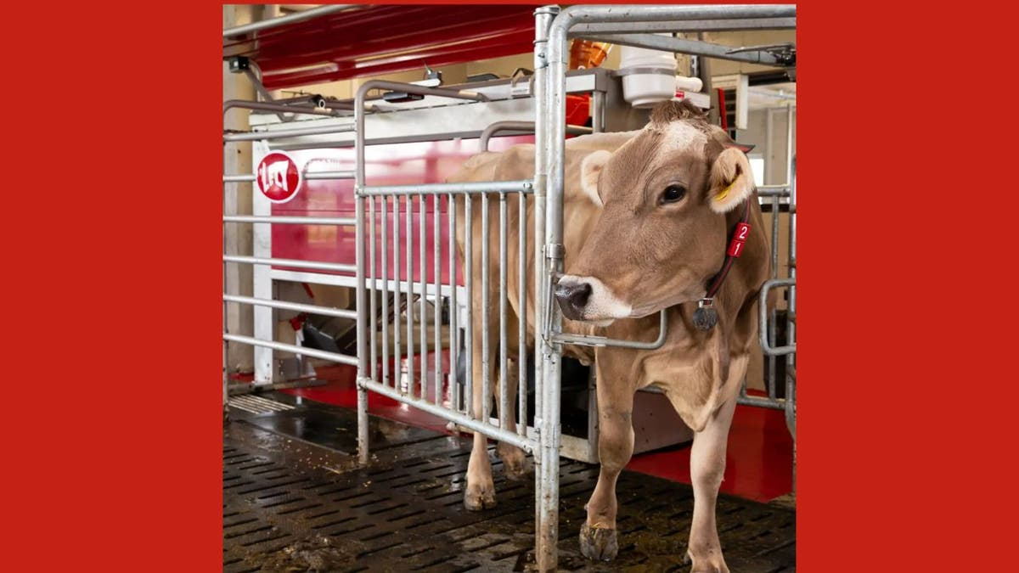


















Comprehensive Digital Transformation
IoT Smart Farming
RFID Tracking
Web Portals
Mobile Apps
Milk Meters & Quality
Public Website
Customer App
Environmental Sensors
B2C E-commerce
Field Sales App
B2B Marketplace
Farmer App
Cattle Wearables
Farm Management
iOS & Android • Offline Capable
Admin Portal
Cold Chain Monitoring
Integrated ERP - Odoo 19 CE
5
3
Sales & CRM
Inventory
Accounting
MRP
Web Portals
Mobile Apps
HR & Payroll
Quality
BI & Analytics
POS
1
100%
Integrated ERP
Traceability
Complete Platform: Unified system connecting farm to consumer

Slide 7













Technology Architecture
Technology Stack
Layered Platform Design
Backend
Frontend
Python 3.11+
React 18
Presentation Layer
FastAPI
Bootstrap 5
Web Browsers • Mobile Apps • IoT Devices
Celery
Tailwind CSS
Application Layer
Mobile
Database
Odoo 19 CE • FastAPI • Background Jobs
Flutter 3.16+
PostgreSQL 16
Dart 3.2+
Redis 7
Data Layer
BLoC / Provider
TimescaleDB
PostgreSQL 16 • Redis 7 • TimescaleDB
99.9%
<2s
<500ms
Infrastructure Layer
Uptime SLA
Page Load
API Response
Docker/K8s • Nginx • AWS/Azure Cloud
Security: TLS 1.2+, AES-256, RBAC
Scalability: Horizontal scaling supported

Slide 8
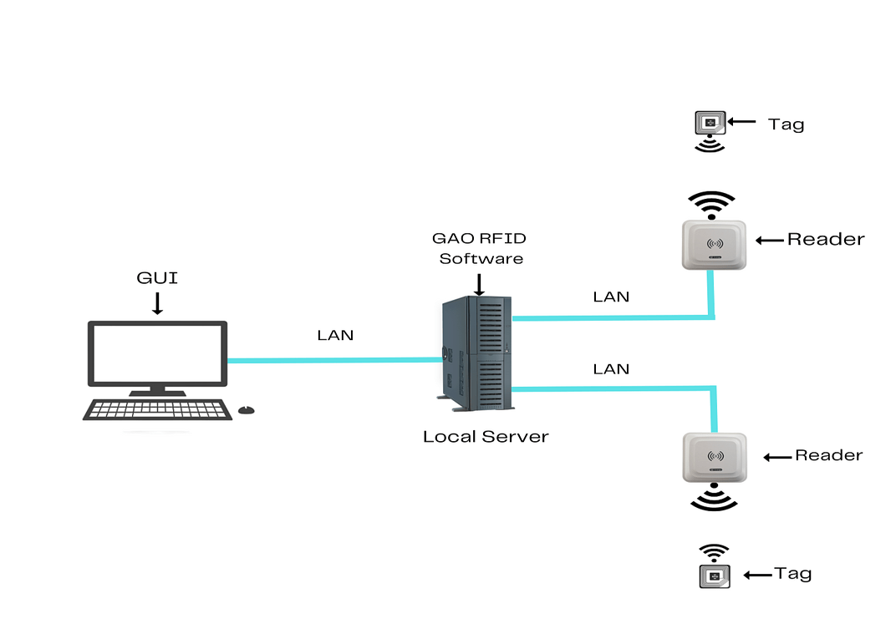




























Security & Compliance
Compliance Requirements
Data Protection
PCI DSS
Data Protection Act
TLS 1.2+ in transit
AES-256 at rest
GDPR compliant
BFSA compliance
Row-level security
Backup encryption
BSTI standards
VAT compliance
Access Control
Security Measures
MFA support
RBAC system
Quarterly pentest
Code reviews
Secure session
OAuth2 + JWT
Weekly scanning
Security training
Incident response
Business continuity
Application Security
99.9%
7+
6+
Input validation
XSS prevention
Security Coverage
Compliance Standards
Active Measures
SQL injection block
CSRF protection
Defense-in-Depth: Multi-layer security approach across all platform components

Slide 9
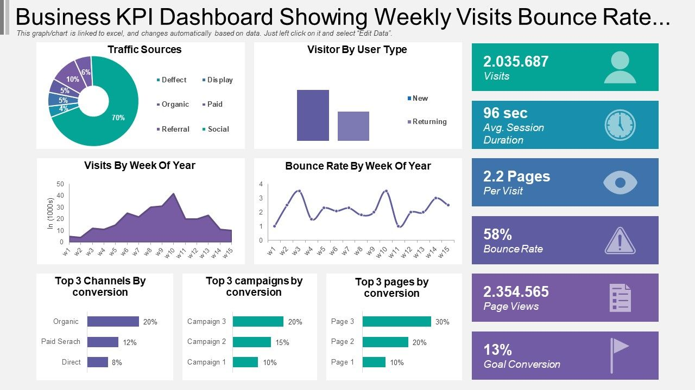






















Performance Specifications
Performance Targets
Scalability
Page Load < 2s
API < 500ms
Horizontal scaling with load balancer
TTFB < 200ms
1,000+ Concurrent
Read replicas, connection pooling
10,000+ Orders/day
99.9% Uptime
Redis cluster for high availability
CDN for static assets
S3-compatible object storage
Web Vitals
LCP < 2.5s
FID < 100ms
Infrastructure
CLS < 0.1
FCP < 1.8s
2× App Servers (16 vCPU, 64GB)
1× DB (32 vCPU, 128GB NVMe)
< 2s
99.9%
10K+
3× Redis Nodes (8GB each)
Page Load
Uptime
Daily Orders
Load Balancer (Nginx/HAProxy)

Slide 10
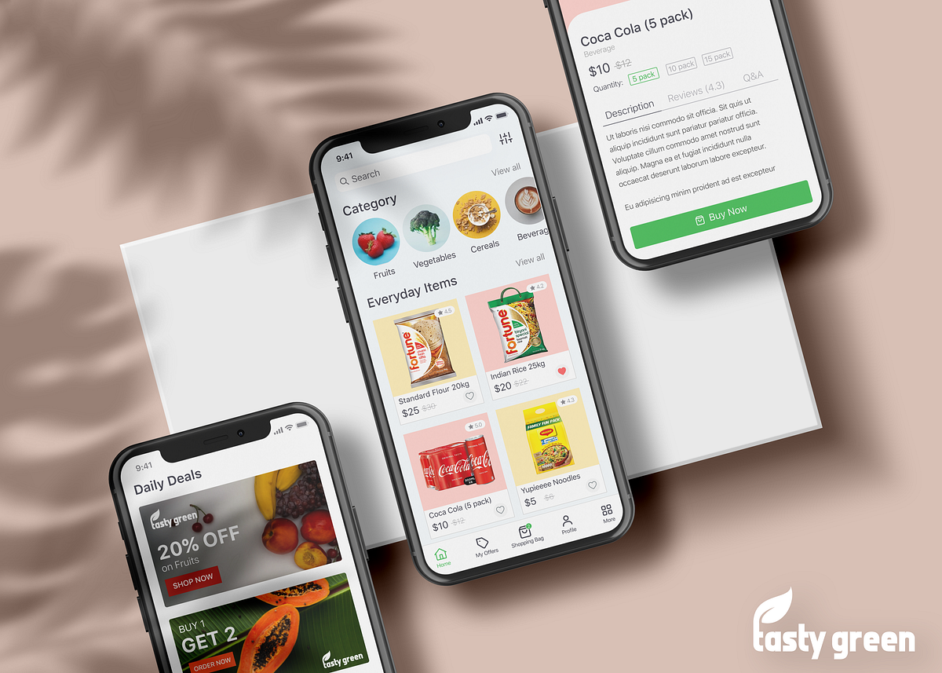








Key Features: Web Portals & Mobile Apps
Subscription Plans
B2C E-commerce
B2B Marketplace
Daily Fresh
10% OFF
Product Catalog & Filtering
Partner Management
Weekly Bundle
7% OFF
Shopping Cart & Checkout
Bulk Ordering (CSV)
Subscription Service
Credit Terms & Limits
Monthly Box
5% OFF
Multiple Payment Options
Volume Discounts
Loyalty Program
Invoice Portal
24/7
5+
Farm Management
Mobile Applications
Online Store
Payment Methods
Herd Tracking (RFID)
Customer App: Ordering & Tracking
Health Records
Field Sales App: Visits & Collections
100%
5-10%
Breeding Management
Farmer App: Data Entry & Tasks
Milk Production Tracking
Offline Capability
Traceability
Subscriber Savings
Feed Management
Push Notifications
Omnichannel Experience: Seamless integration across web and mobile

Slide 11
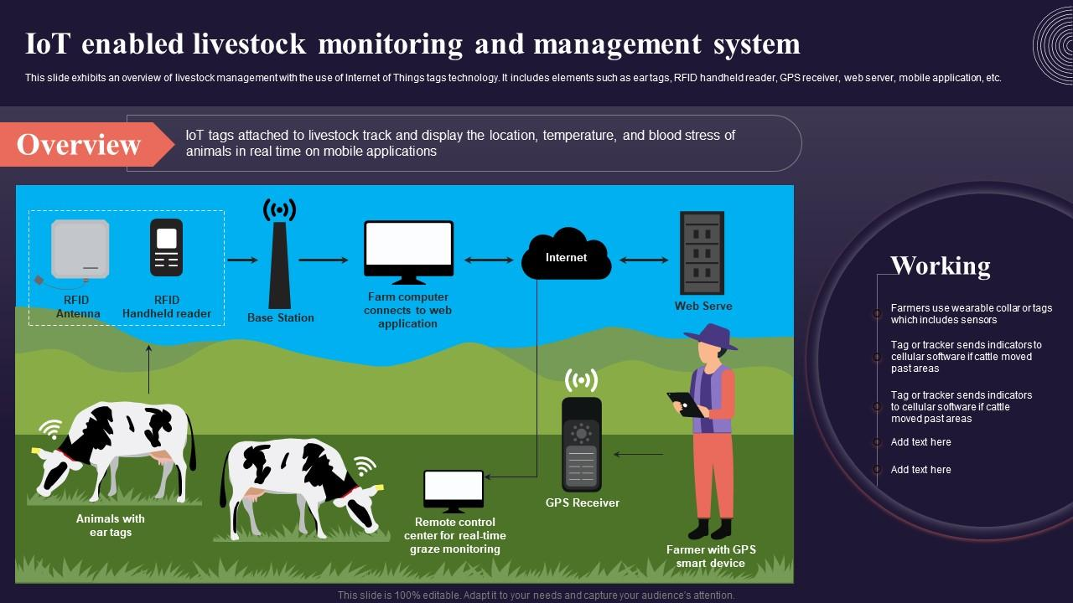













IoT Smart Farming
Real-Time Monitoring Network
Automated Alerts
Milk Meters
Quality Analyzers
Health anomalies
• Volume tracking
• Fat% & SNF%
Estrus detection
• Temperature monitoring
• Protein & lactose%
Treatment reminders
• Conductivity testing
• Density measurement
Quality deviations
Environmental Sensors
Cattle Wearables
• Barn temperature
• Activity tracking
24/7
100%
Real-Time
• Humidity levels
• Heat detection
Monitoring
Uptime
• Air quality monitoring
• Rumination monitoring
Data Flow
Cold Chain
RFID Tracking
• Temperature alerts
• Individual cow ID
Smart Automation: Feeding systems, climate control, milking integration
• Humidity control
• Lineage tracking
• Quality assurance
• Farm-to-fork data
MQTT Protocol
LoRaWAN

Slide 12










Implementation Approach: 15-Phase Agile Methodology
Development Team
1-4
Foundation
5-8
Operations
Backend Lead
1
Odoo • Python • DB/API
• Infrastructure Setup
• Farm Management
• Security Framework
• Mobile Apps
2
Full-Stack Dev
• ERP Core Config
• E-commerce Core
Frontend/Backend • Testing
• Public Website
• Payment Integration
3
Frontend/Mobile Lead
Flutter • UI/UX • Web
9-12
Commerce
13-15
Optimization
• B2B Portal
• Performance Tuning
Agile Practices
• IoT Integration
• Testing & QA
Daily Standup
Weekly Sprint
• Advanced Analytics
• Deployment
• Subscriptions
• Handover
Code Review
CI/CD Pipeline
Duration: 24-30 months
150 Milestones
10 days/milestone
3
150
100%
Developers
Milestones
Code Coverage

Slide 13
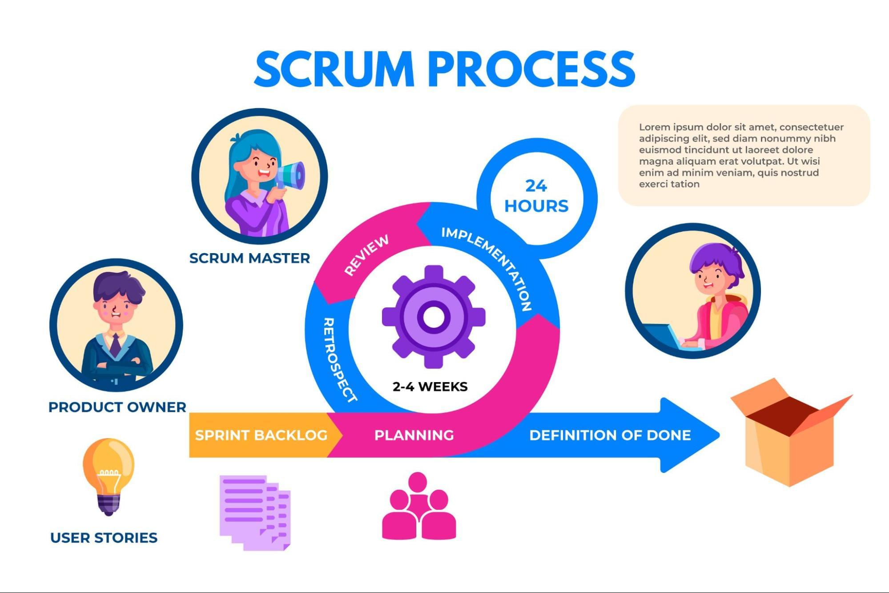








Risk Management
Contingency Plans
Key Risks & Mitigation
Developer Unavailability
Cross-trained backup, external contractor pool
M
Team Capacity
Med
High
Technology Platform Issues
Cross-training, documentation, priority focus
Odoo 18 CE fallback, alternative components
L
Technology Changes
Low
Med
Payment Gateway Failure
Modular architecture, abstraction layers
Multiple gateway integration, manual fallback
M
Integration Failures
Med
High
Data Loss
Early POC, fallback providers, robust testing
Real-time replication, daily backups, DR site
Scope Creep
High
Med
Security Breach
H
Incident response plan, communication protocol
Strict change control, prioritized backlog
M
Bangladesh Infrastructure
Med
Med
Offline capabilities, local caching
7
5
Proactive
M
Stakeholder Availability
Med
Med
Key Risks Identified
Contingency Plans Ready
Risk Management
Scheduled reviews, async feedback
Risk-Based Approach: Continuous monitoring, proactive mitigation, robust contingency planning

Slide 14
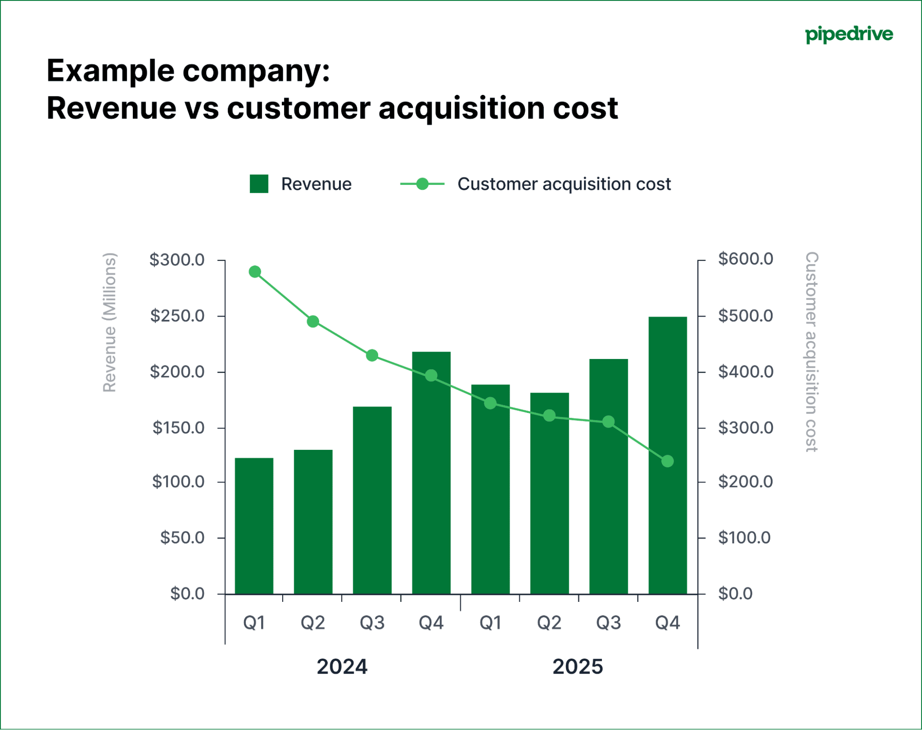







Project Investment & ROI
Expected ROI
BDT 7.00 Cr
Payback Period
18-24 months
Year 1 Implementation Cost
Total Investment
Year 3 Revenue Target
Phase 1
Phase 2
Phase 3
Phase 4
BDT 100+ Cr
1.50 Cr
2.20 Cr
1.85 Cr
1.45 Cr
Foundation
Operations
Commerce
Optimization
3x
99.9%
Business Growth Support
System Uptime Target
3-Year Total Cost of Ownership
Year 1
Year 2
Year 3
70%
95%+
7.00 Cr
1.50 Cr
1.00 Cr
9.50 Cr
Manual Data Reduction
Customer Satisfaction
Implementation
Operations
Maintenance
Total TCO
Investment Breakdown: Capital 5.50 Cr + Operations 1.50 Cr (Year 1)

Slide 15






Lessons Learned
Bangladesh Localization is Critical
Change Management with Traditional Practices
VAT compliance • Local payment gateways • Bengali language • SMS gateway • Postal zones
Extensive training • Gradual rollout • Organizational champions • Quick wins • Patience
Key Learning:
Allocate dedicated time; not simple configuration
Key Learning:
30% technical, 70% change management
IoT Integration Requires Field Expertise
Phased Delivery Maintains Momentum
Power reliability • Rural connectivity • Environmental conditions • Equipment integration
Regular deliverables • Early wins • Issue identification • Flexibility to adjust scope
Key Learning:
Extensive field testing + fallback mechanisms
Key Learning:
Incremental delivery with regular checkpoints
Mobile-First for Field Operations
5
15
100%
Offline capability • Simplified UI • Quick data entry • Photo capture
Critical Insights
Phases Completed
Applied Learning
Key Learning:
Design for field conditions, not smaller screens
Success Formula: Technology Excellence + Cultural Adaptation + Change Management = Transformation

Slide 16
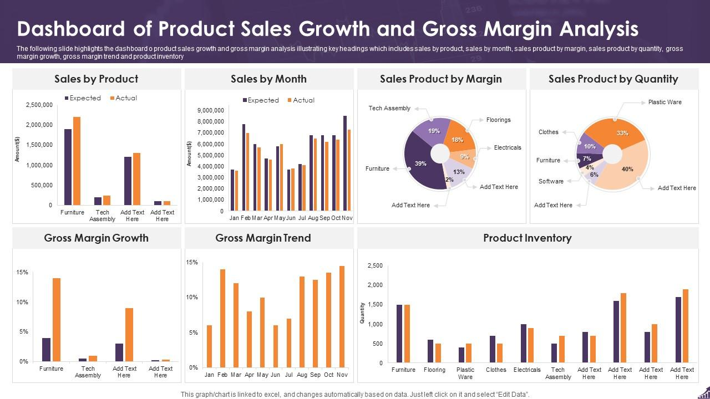












Expected Outcomes: Operational & Business Impact
Operational Excellence
Customer Impact
Manual Data Entry
100% → 30%
24/7 Ordering
Home Delivery
Inventory Accuracy
80% → 99.5%
Virtual Farm Tour
Traceability
Order Processing
4hrs → 1.3hrs
Customer Satisfaction
95%+
Quality Incidents
Multiple → Near zero
System Capabilities
Revenue Enablement
100% Traceability
Real-time Monitoring
E-commerce
Subscriptions
B2B Portal
1,000+ Concurrent Users
99.9% Uptime
5% → 25%
10% → 40%
20% → 40%
Year 3 Revenue Target
BDT 100 Cr
10,000+
3x
100%
Daily Orders
Growth Support
Farm-to-Fork

Slide 17
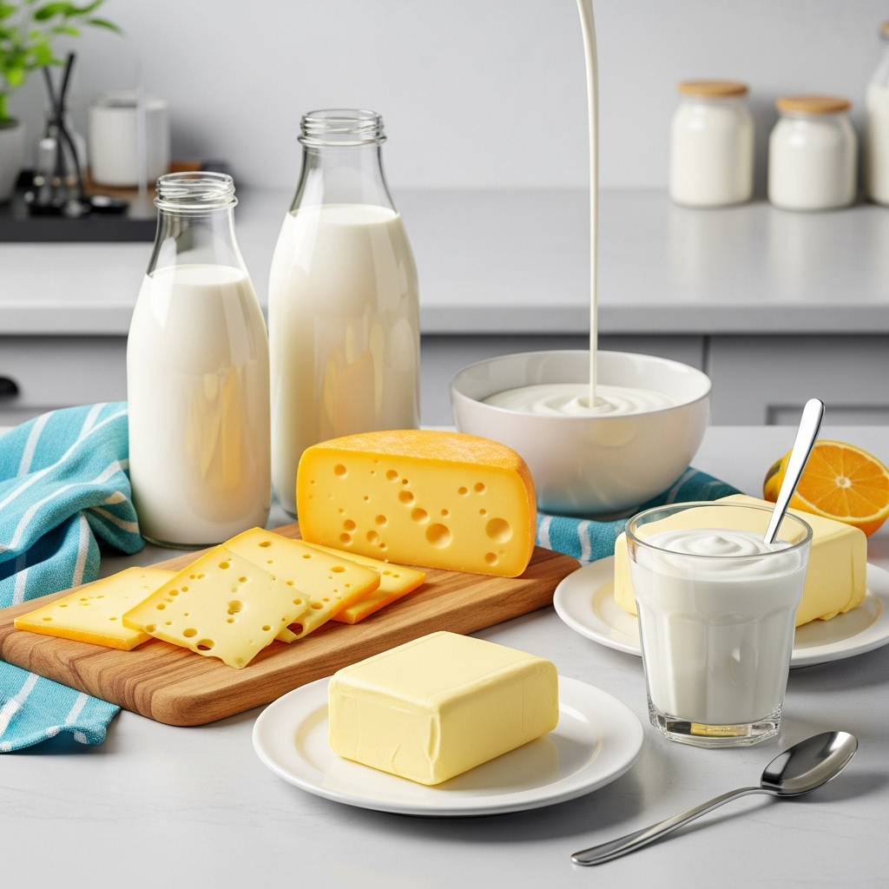










Competitive Positioning & Market Differentiation
Differentiation Strategy
Competitive Landscape
Technology Leadership
Transparency
Only comprehensive digital platform
Virtual tour, traceability
Milk Vita
40%
Quality
Convenience
Aarong (BRAC)
15%
Certified organic, antibiotic-free
E-commerce, subscriptions, apps
Pran Dairy
12%
Trust
Ecosystem
Akij Group
8%
Farm visibility, certifications
Integrated products & services
Others
25%
Brand: Saffron
Market Gap: No major player with comprehensive digital transformation
"Pure as nature intended, delivered with technology"
Purity
Trust
Innovation
Care
Premium

Slide 18
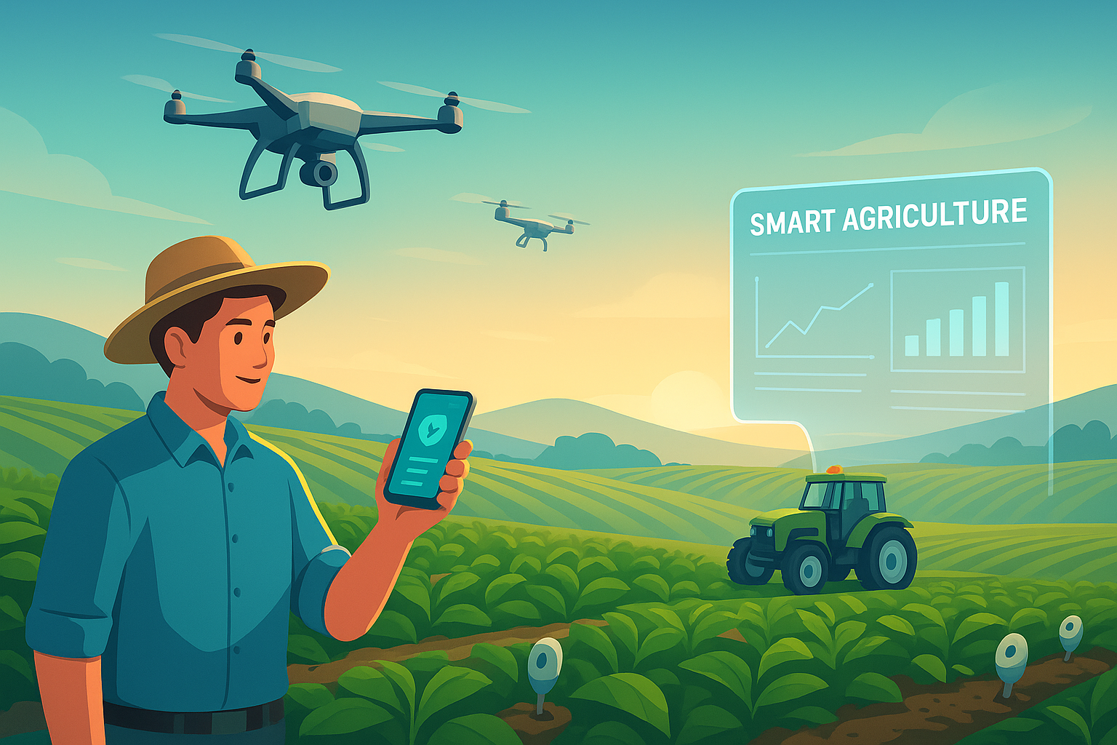
















Future Roadmap: Vision for Growth
Short-Term (6-12 Months)
Key Milestones
AI/ML optimization
Expanded IoT network
Year 3 Revenue
BDT 100+ Cr
Enhanced mobile apps
Advanced analytics
Market Leadership
Premium Organic
National Coverage
Complete
Medium-Term (1-2 Years)
Equipment sales launch
Digital Academy platform
10,000+
BDT 100 Cr
Genetics services
Regional hubs
1,000+
Farmers
300+
B2B Partners
Farmers Network
Revenue Target
100%
Export
Long-Term (3-5 Years)
Traceability
Market Entry
Market leadership
10,000+ farmers ecosystem
Blockchain traceability
Export market entry
Ecosystem Vision: Technology-enabled, quality-focused, sustainable dairy enterprise

Slide 19
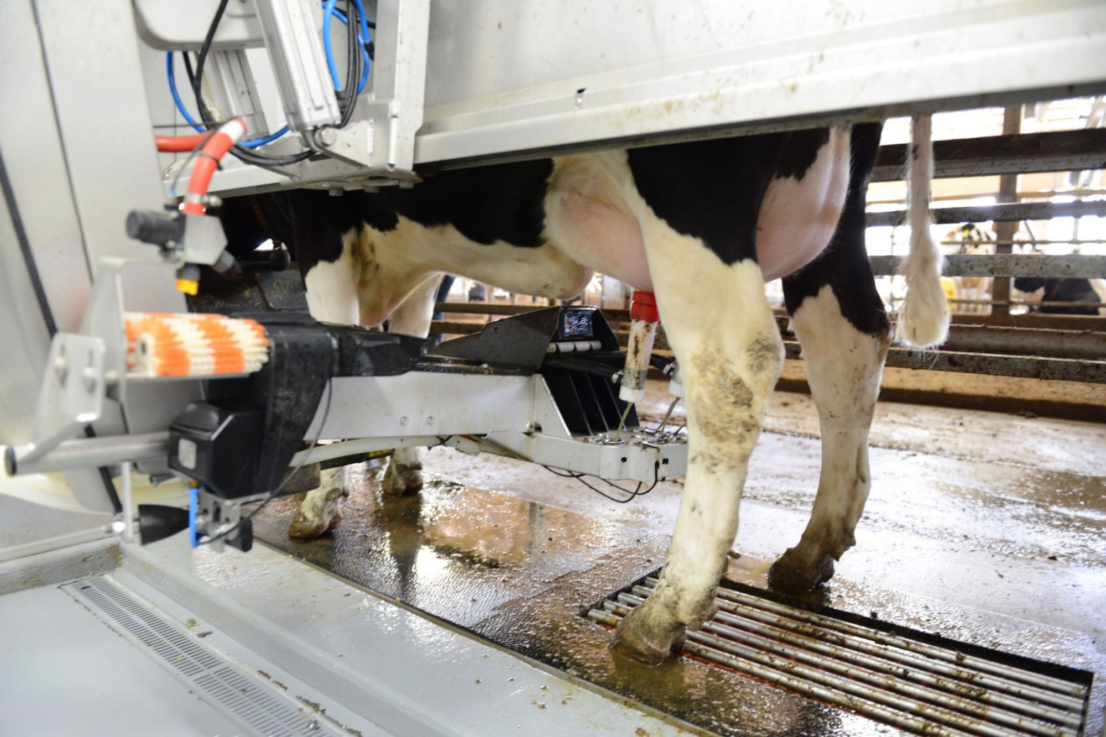

















Conclusion: Key Takeaways & Call to Action
Transformation Impact
Evolved from traditional farm to technology-enabled enterprise
Success Factors
Positioned to lead Bangladesh's premium dairy market
Clear vision from day one
Supporting 3x growth without proportional costs
Strong sponsorship from Smart Group leadership
Complete farm-to-fork transparency
Empowering farmers and partners through digital tools
Right technology choices - open-source, proven, scalable
Focused team of 3 full-stack developers
Phased approach with regular value delivery
Call to Action
Change management investment in training
Consumers: Experience pure, traceable dairy products
Partners: Join Smart Dairy network as distributor/retailer
Key Learning: Technology implementation is 30% technical, 70% change management
Farmers: Partner for genetics, training, equipment, market access
smartdairybd.com
Contact Us
info@smartdairybd.com

